Slide 1

Unit 7

Slide 2
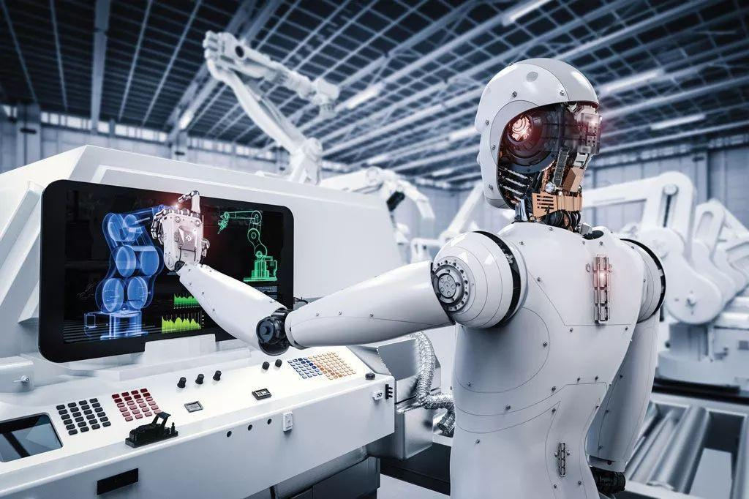
Unit 7
Will people have robots?

Slide 3
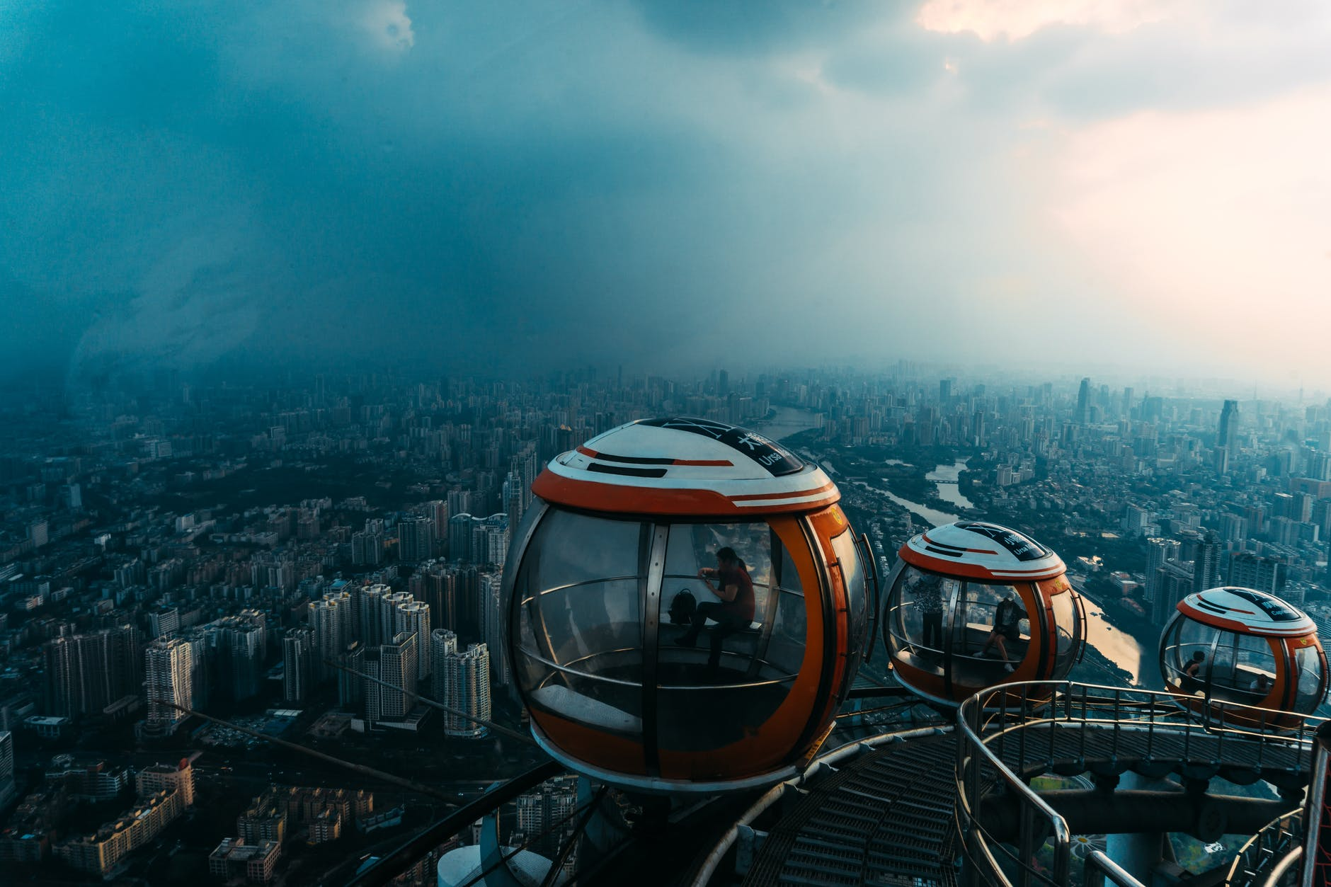


Slide 4


Write each word in the correct column below.
n.宇航员；航天员
n.公寓套房
n.火箭
astronaut house apartment train rocket space station computer programmer
太空站；
宇宙空间站
Jobs | Transportation | Places to live
astronaut
train
house
apartment
computer programmer
rocket
space station

Slide 5

Think of other words and write them in the chart.
Jobs | Transportation | Places to live
cook
driver
doctor
engineer
…P41
bus
car
subway
plane
…
building
farm
hotel
bedroom
…

Slide 6


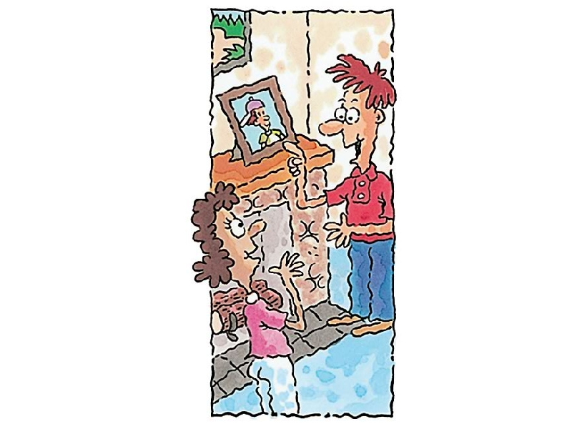
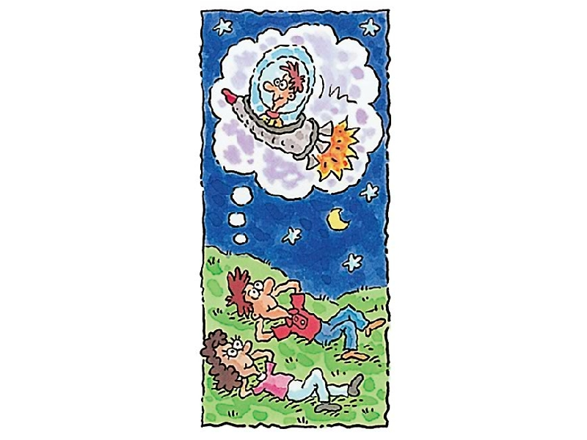
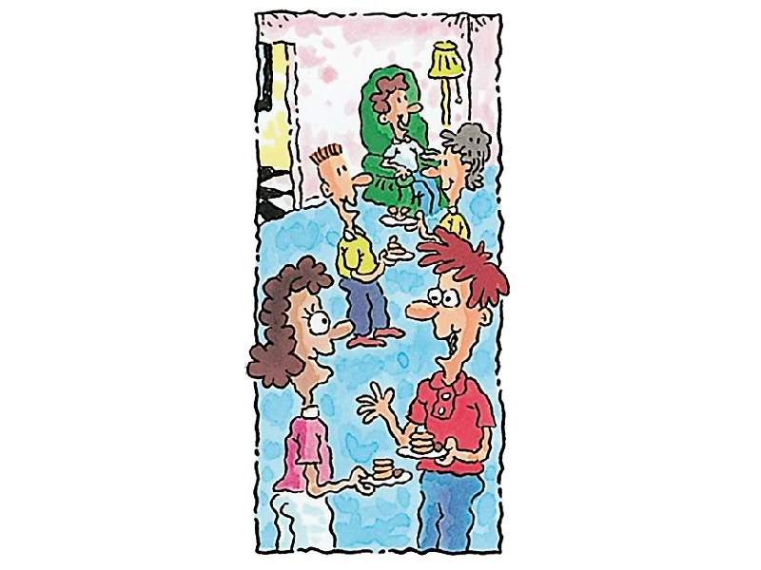
Look at the pictures and predict.
—What’s this?
—It’s a picture
of Job before.
—What are Alexis and Joe doing?
—They’re talking.
—What does Job want to be in the future?
—He wants to be an astronaut in a rocket.
The conversations maybe talk about Job’s lives before, now and in the future.

Slide 7



Listen to Alexis and Joe. Number the pictures [1-3].
2
3
1

Slide 8

Listen again.
Fill in the blanks with the correct verbs in the box.
am, live, work
lived, took
will be, will live, will fly
动词原形—一般现在时
动词过去式—一般过去时
will+动词原形 —一般将来时

Slide 9
am, live, work
lived, took,
will be, will live, will fly
1. I _____ in an apartment across the street from here.
2. I _____ near here.
3. I _____ a computer programmer.
4. We _____ in a house in the country.
live
work
am
lived
5. I _____ the train to school.
6. I _______ an astronaut.
7. I _______ rockets to the moon.
8. I _______ on a space station.
took
will be
will fly
will live

Slide 10
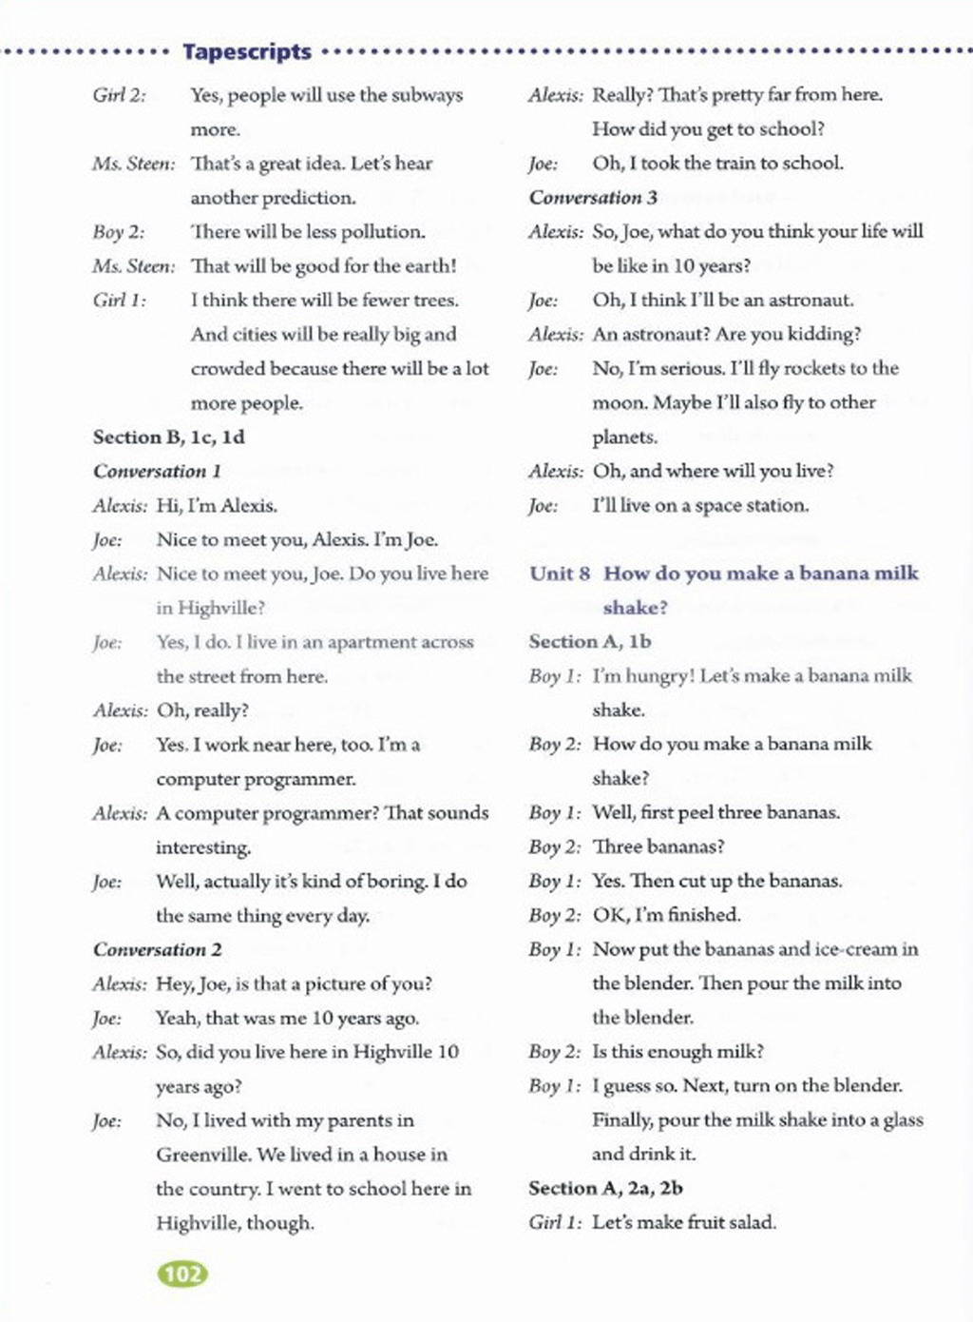
听力原文

Slide 11
Try to retell the conversation.
Ten years ago, Joe lived with his parents in a ________ in the country. He took _________ to school.
Now Joe lives in an __________ in Highville and works near there. He is a ___________ ____________. He thinks it’s kind of _______.
In ten years, Joe thinks he will be an __________. He will fly ________ to the moon. And he will live on a _________ _________.
house
the train
apartment
computer programmer
boring
astronaut
space
station
rockets

Slide 12




Student A is Alexis and Student B is Joe. Talk about Joe’s life now, 10 years ago and 10 years from now.
I live in an apartment.
Where do you live?
I lived in a house in the country.
Where did you live ten years ago?
I will live on a space station.
Where will you live in ten years?

Slide 14
Student A is Alexis and Student B is Joe. Talk about Joe’s life now, 10 years ago and 10 years from now.
I live in an apartment.
Where do you live?

Slide 15



To learn new words and expressions about future life.
To listen for specific information.
To be able to describe personal life in the future with the simple future tense.

Slide 16


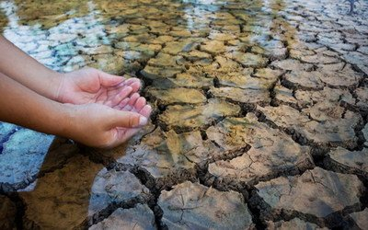
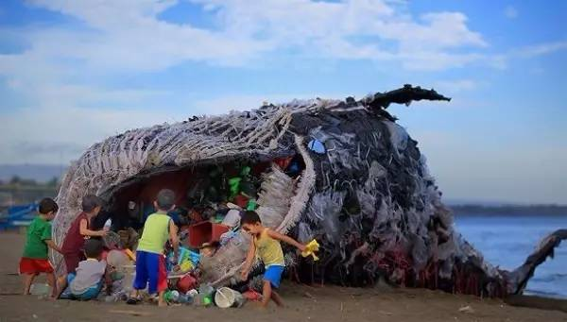
Look at the pictures. Then use more, less or fewer to talk about what may happen in the future.
There will be less fresh water because there will be more pollution in the sea.

Slide 17
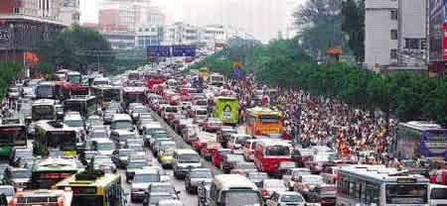
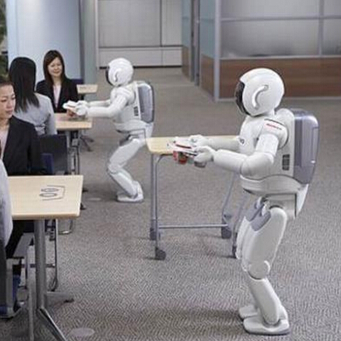
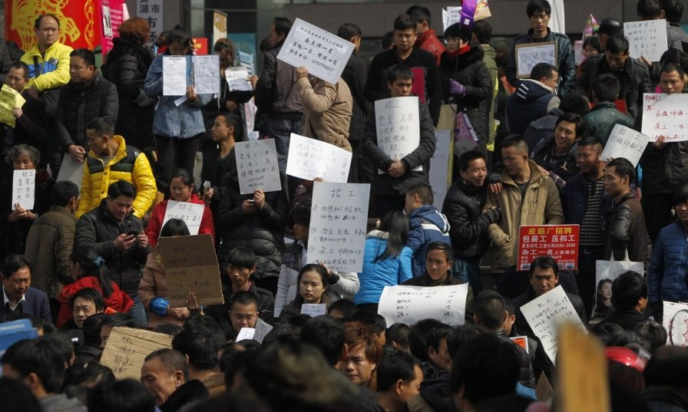
There will be more cars because there will be more people in the cities.
There will be fewer jobs for people because more robots will do the same jobs as people.

Slide 18
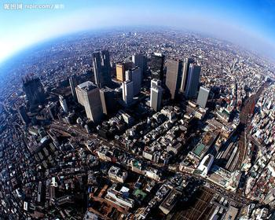
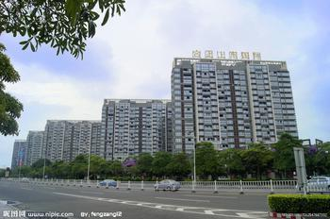

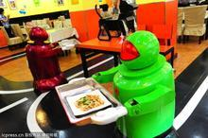
There will be more cities because people will build more buildings in the country.
People will have more free time because there will be less things to do.

Slide 19



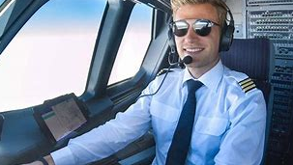
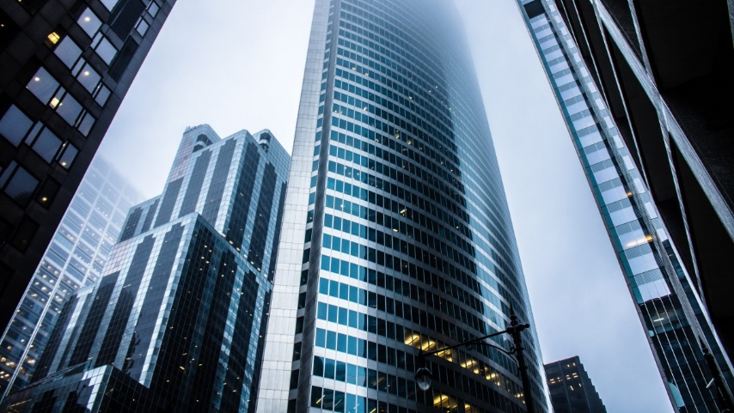
What will you do in the future?
I will be a pilot.
Where will you live?
I will live in a high building.

Slide 20
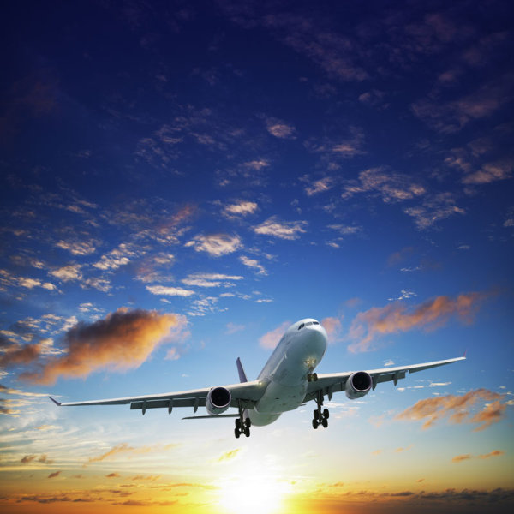

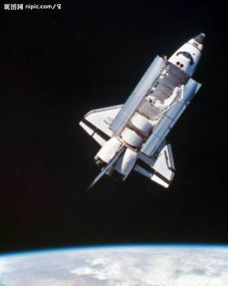

How will you travel?
I will travel by plane.
I will be an astronaut. I will live in other planets. I will go to work by spaceship.

Slide 21

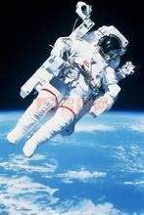

An astronaut lives in a space station. He/She goes to work by rocket.
A programmer lives in an apartment. He usually goes to work by subway or bus.

Slide 22
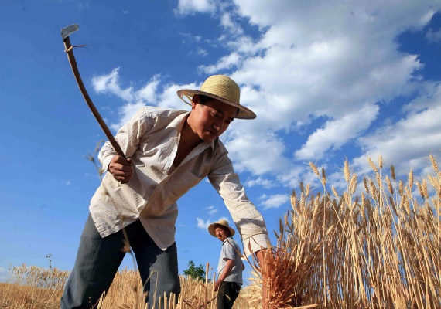

A farmer lives in a house.
He usually walks to the farm.
An engineer lives in an apartment. He usually goes to work by car or by bus.

Slide 23
Listen again. Fill in the blanks with the correct verbs in the box.
听力指导：
通过读句子及方框中的单词可以看出，题目的重点是要听清句子的时态，因此在听时应重点听句子的谓语动词，并明确其时态。如果不能快速写下来，可以先做标记，在听完后再写完整。

Slide 24
Write about your and your partner’s life in ten years. Then report it to class.
Jobs | Places to live | Transportation
I’ll be a businessman. I’ll live in a big house. I’ll be away on business by plane.
He’ll be a doctor. He’ll live in an apartment. He’ll walk to work.

Slide 25


live in an apartment
fly rockets to the moon
live on a space station
I will be an astronaut.
I will fly rockets to the moon.
I will live on a space station.

Slide 26

句型转换。
1. Peter will wash his car this afternoon. (改为一般疑问句并补全否定答语)
—_______ Peter _______ his car this afternoon?
—No, _______ _______.
2. There will be a prize for the winner of the game. (改为一般疑问句并补全肯定答语)
—_______ _______ _______ a prize for the winner of the game?
—Yes, _______ _______.
Will wash
he won’t
Will there be
there will

Slide 27
3. Next summer Ann will go to the beach on holiday. (改为否定句)
Next summer Ann _______ _______ to the beach on holiday.
4. Mrs. Smith will have a baby in a few weeks. (对划线部分提问)
_______ _______ Mrs. Smith _______ a baby?
5. I will stay at my aunt’s home next year. (对划线部分提问)
_______ _______ you _______ next year?
won’t go
When will have
Where will stay

Slide 28


Preview the passage on page 53.
Talk about your life now, 10 years ago and 10 years from now.

Slide 29


